Slide 1
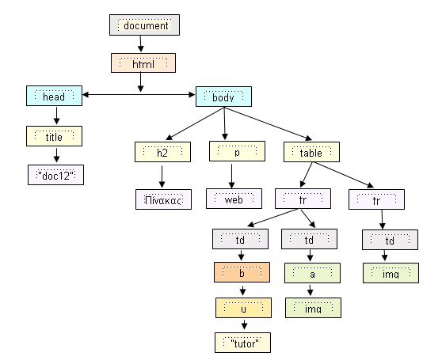
Part 1 : Intro to the Web

Slide 2
The web works as a vast system that connects people, devices, and information globally. Here's how it operates, step by step:
Web Pages & Websites: Websites are made up of web pages that store content like text, images, and videos using HTML, CSS, and JavaScript.
Web Servers: Web pages are hosted on servers specialized computers that store and deliver website content. These servers are always online, ready to respond to requests.
URLs and DNS: Every website has a unique address called a URL (e.g., "www.example.com"). The Domain Name System (DNS) translates this human-readable name into an IP address that computers use to identify the server.
Web Browsers: A browser (like Chrome, Safari, or Edge) acts as the client, sending a request to the server for the web page when you enter a URL or click a link.
HTTP/HTTPS: The browser and server communicate using protocols like HTTP or the secure HTTPS to exchange information.
Data Transmission: The server sends the requested page's content (e.g., text, images, code) back to the browser, which processes and displays it for you.
APIs & Databases: Websites often pull dynamic data using APIs or query databases, such as fetching user-specific information or product details.
Caching & CDNs: To improve speed, frequently accessed content might be cached (temporarily stored) or delivered via Content Delivery Networks (CDNs) located near the user.
Search Engines: Tools like Google index web pages, making it easy to search for specific information

Slide 3
What do you need to be a web developer?
To become a web developer, i need a mix of technical skills, tools, and soft skills. Here's an overview of what i will need :
Technical Skills
1. HTML, CSS, and JavaScript : The building blocks of websites. HTML structures the content, CSS styles it, and JavaScript adds interactivity.
2. Programming Skills : Familiarity with languages like Python, PHP, or Ruby can be helpful for backend development, but now we have mongoDB, accumulo, node.Js etc...
3. Version Control : Tools like Git and GitHub for managing code changes and collaboration.
4. Frameworks and Libraries : Knowledge of frameworks like React.js (frontend) or Node.js (backend) makes development faster and more scalable.
5. Database Management : Understanding databases (e.g., MySQL, MongoDB) for storing and retrieving data.
6. Responsive Design : Ability to create websites that work well on mobile, tablets, laptop and desktops.
Tools
- Code editors like VS Code, Sublime Text, or Atom.
- Debugging tools for identifying and fixing issues.
APIs for integrating external functionalities like payment gateways or weather data.
Soft Skills
- Problem-Solving : Web development often involves debugging and finding creative solutions to challenges.

Slide 4
Why did you choose to learn web development?
I chose to learn web development because I was asked many times to make a beautiful website but my design wasn't beautiful enough, i also wanted to be part of the digital revolution that connects people, businesses, and ideas globally. Web development offers an incredible mix of creativity and problem-solving, allowing me to create user-friendly experiences and impactful designs. Furthermore, this field is constantly evolving, which motivates me and pushes me to learn new technologies and improve my skills. I find it exciting to create something from scratch and see it come to life on the web, making a real difference.

